Slide 1
Auto Pilot
Task 5

Slide 2
Task 5
Team members
name | sec | bn
Mohammed Ahmed Hassan Ahmed | 2 | 37
Ibrahim Thabet Allam | 1 | 1
Mohammed Hatem Mohammed Saeed | 2 | 39
Mohamed Hassan Gad Ali | 2 | 41
Mohammed Abd El Mawgoud Ghoneam | 2 | 43

Slide 3
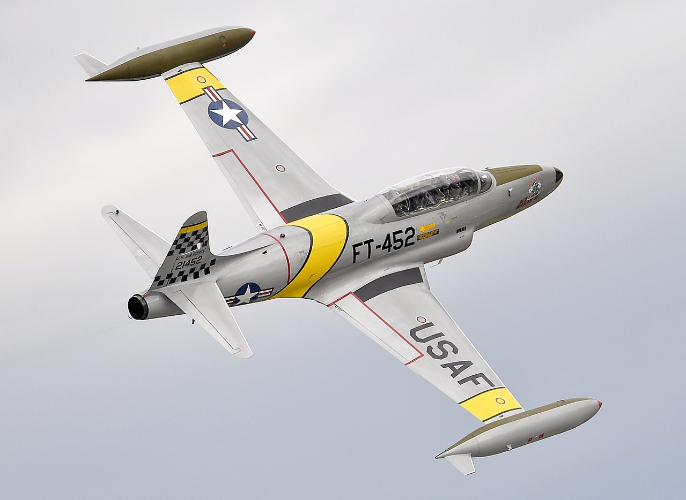
NT-33A engine
Our aircraft ‘NT-33A’ was a training aircraft that was developed from the Lockheed martin.
The Powerplant installed is 1 × Allison J33-A-35 centrifugal flow turbojet engine, with 5,400 lbf (24 kN) thrust for take-off with water injection
4,600 lbf (20,461.82 N) maximum continuous thrust.

Slide 4
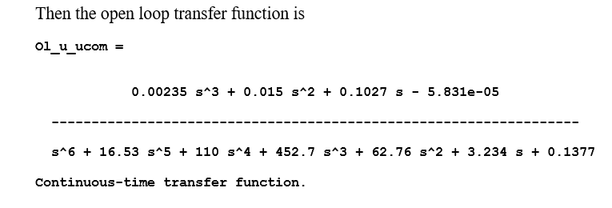
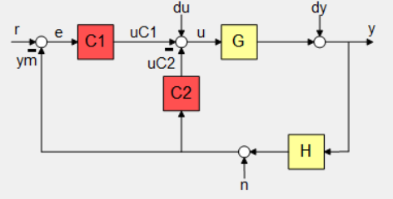
Velocity Controller

Slide 5
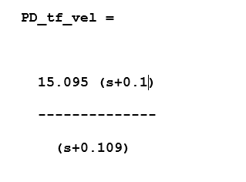
PD and PID Controllers

Slide 6
Step response & Control action
Step response
Control action

Slide 7
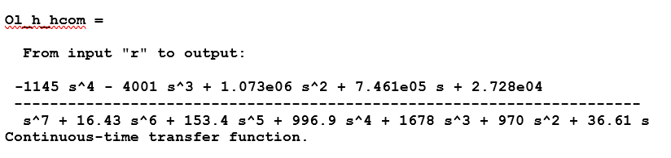
Altitude controller

Slide 8
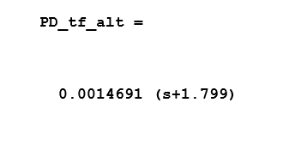
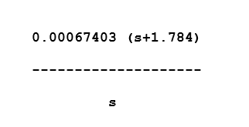
PD and PID Controllers

Slide 9
Step response & Control action
Step response
Control action

Slide 10

simulation
Results

Slide 11
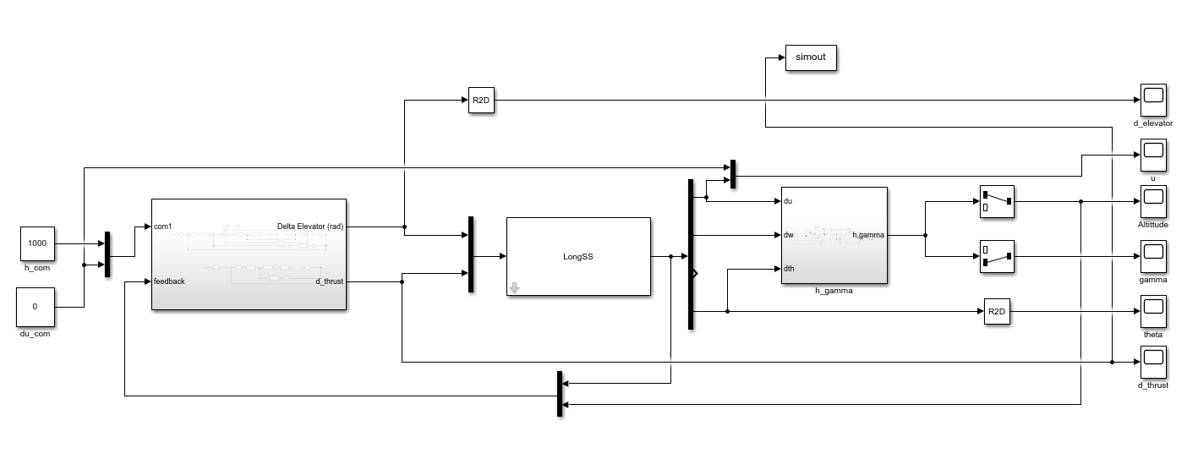
Simulation Blocks

Slide 12
Simulink Results

Slide 13
Simulink Results

Slide 14
Simulink Results

Slide 15
Thanks

